Slide 1
Dark Energy

Slide 2
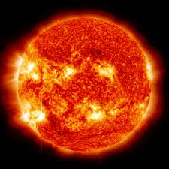
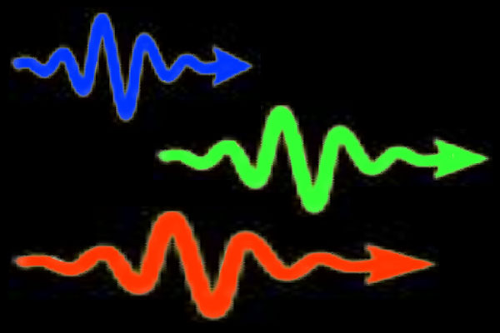
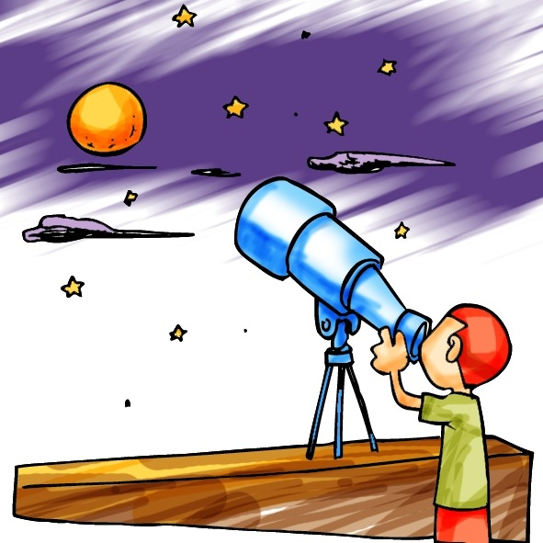
The most amazing fact ever
DISTANCE = 150 MILLION KM
(93 MILLION MILES)
TIME = D/V = 150 MILLION KM/(300,000 KM/S) =
500 S ~ 8 MINUTES

Slide 3
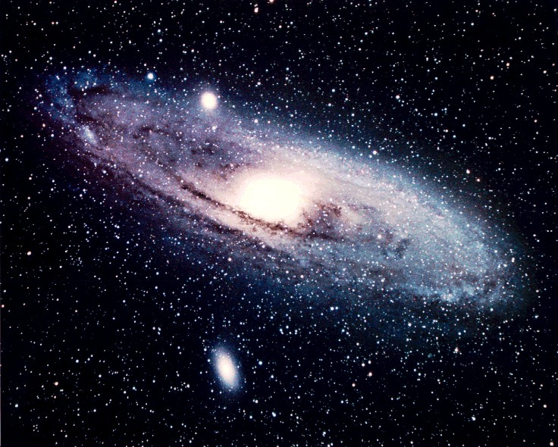
The most amazing fact ever
DISTANCE = 2.5 million light years
TIME (conveniently) =
2.5 million years
Looking far away means looking back in time

Slide 4
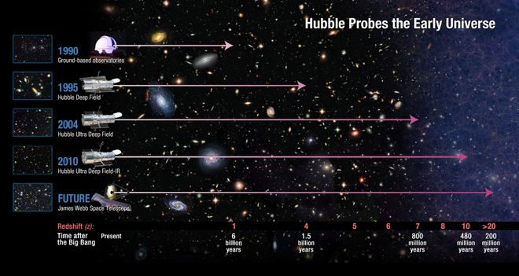
The sky is the limit!
AS WE MAKE BETTER AND BETTER TELESCOPES,
WE GET A PEEK AT INCREASINGLY REMOTE TIMES.

Slide 5
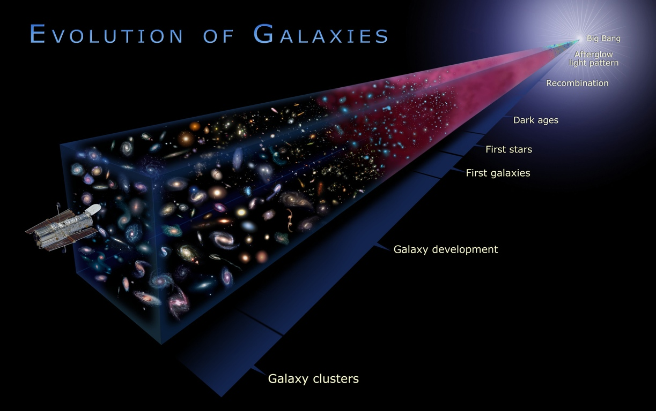
This gives us the chance of observing the history of the Universe.

Slide 6
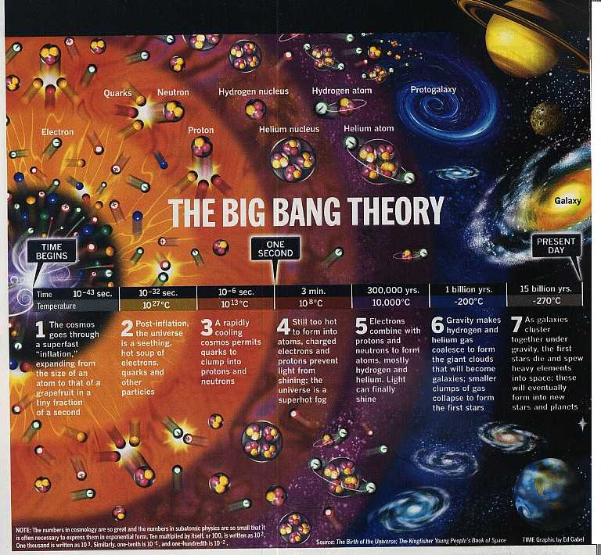
Our main prediction is that the Universe has been expanding.
Notes:
Expanding and cooling: go back, small, hot and dense

Slide 7
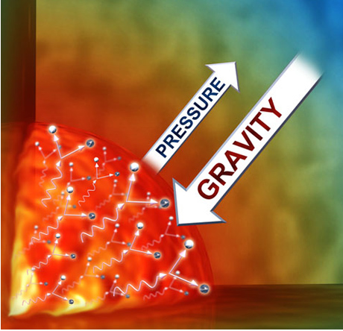
It’s all a balance of two forces…
“section”
of the young,
hot
Universe
The balance between pressure (initial momentum)
and gravity tells us the rate of the expansion of the Universe
Can you predict what happens with more/less matter?
Would the expansion be accelerating or slowing down?

Slide 8

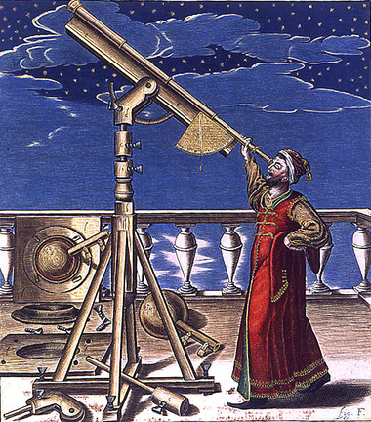
B=20
B=20
B=20
Stars have different
luminosities, and measuring
how bright they appear
is not enough to know their distance ☹
You can weigh the Universe
by measuring distance!
Smaller distance ⇔ Slower expansion

Slide 9

What if he had light bulbs, instead of stars?
60 W
60 W
60 W
Would he be able to know
how far the light bulbs are
from their apparent brightness?
YES!
Because all the light bulbs
have the same luminosity,
and so the dimmer ones must be farther away.
ARE THERE ASTRONOMICAL LIGHT BULBS?

Slide 10
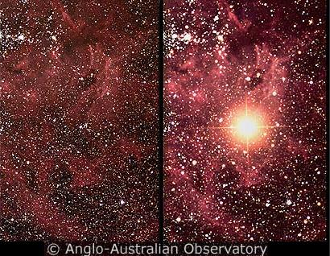
YES! They are called SUPERNOVAE Type Ia.
A supernova is an explosion from either
a massive star or from a white dwarf (Type Ia)
It is really bright, and it is visible for months or years.
But why is it so special?

Slide 11
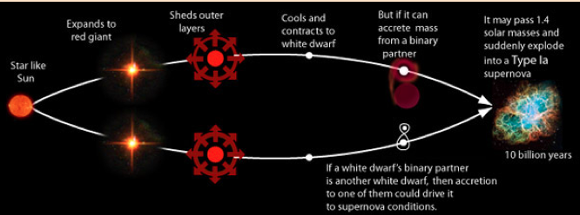
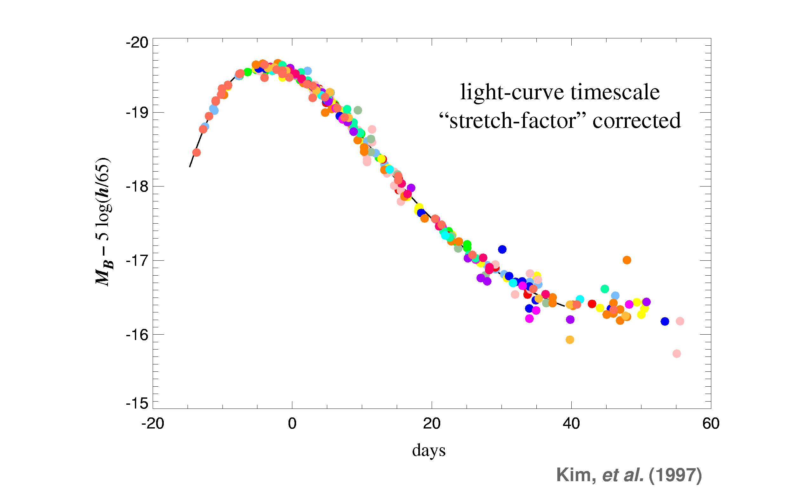
THE SPECIAL THING IS THAT THEY ARE ALL BORN EQUAL
SN Type Ia all have the same mass
when they explode, and therefore,
they are equally bright.
Astronomers call them
STANDARD CANDLES.

Slide 12
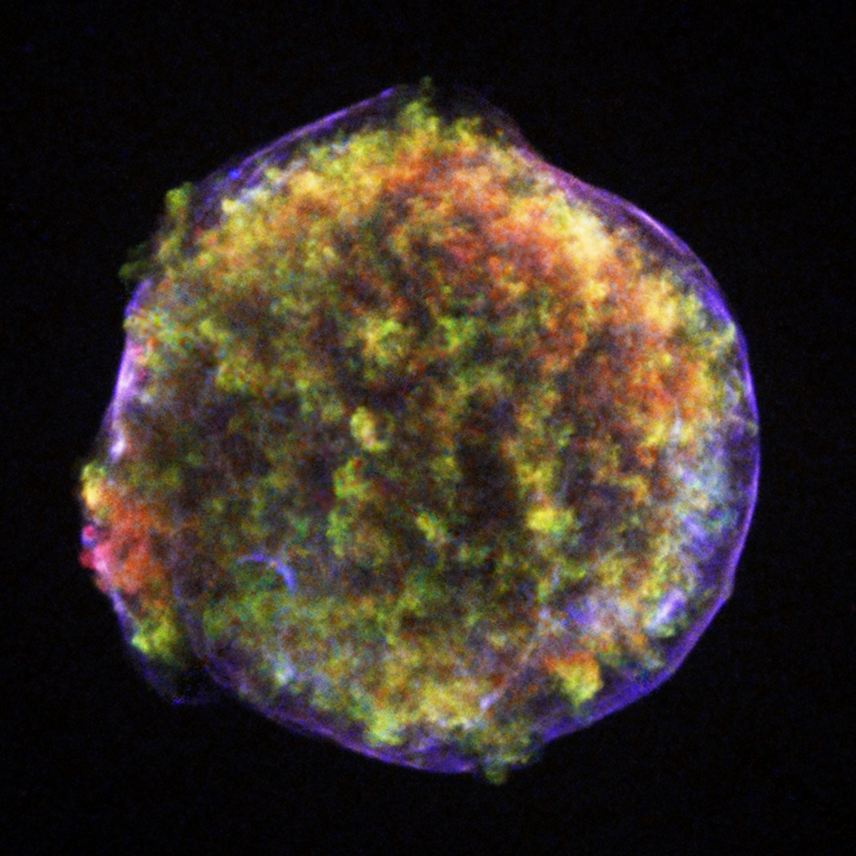
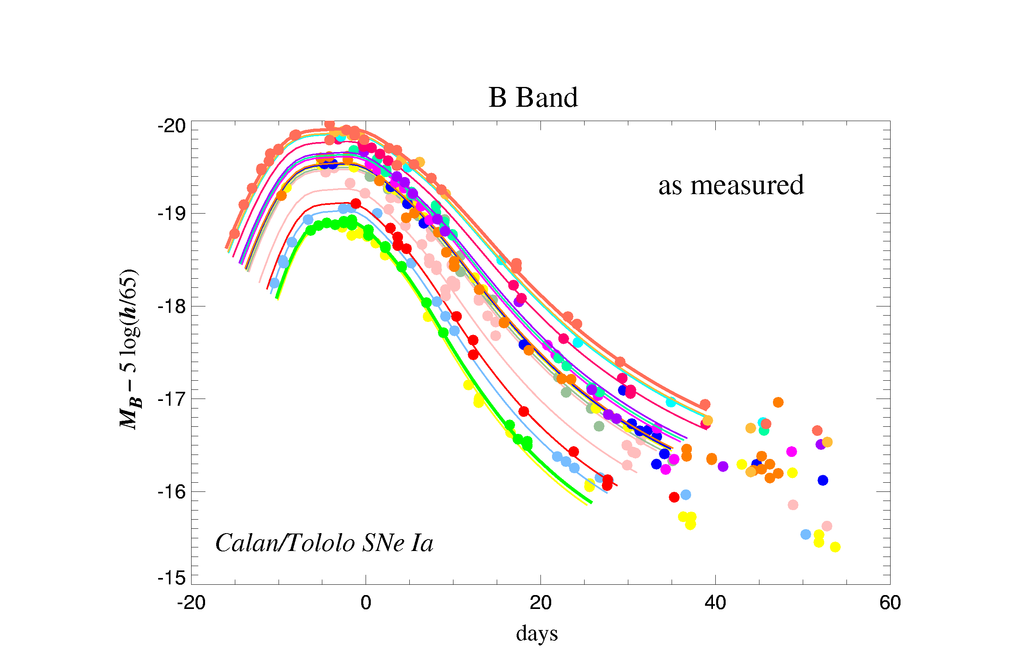
SUPERNOVAE TYPE Ia AS STANDARDIZABLE CANDLES
Violent explosions of
white dwarf stars
Have similar absolute magnitude because of similar birth process
Very bright!

Slide 13
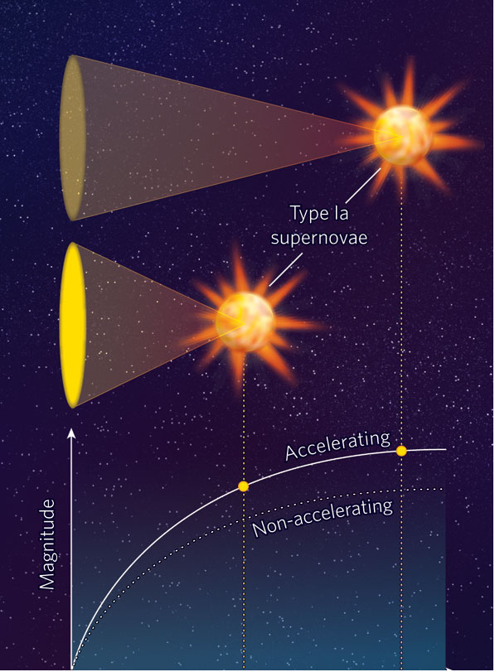
Astronomers decided to use these SNe to measure the rate of the expansion…
And found that they were ALL dimmer than expected, suggesting that the expansion was proceeding at a much higher rate than previously thought.
observed
expected
NOW, THIS WAS
A BIG SHOCK.
Notes:
My career at the time; how often crazy results just means that there is an error.

Slide 14
http://hubblesite.org/hubble_discoveries/dark_energy/

Slide 15
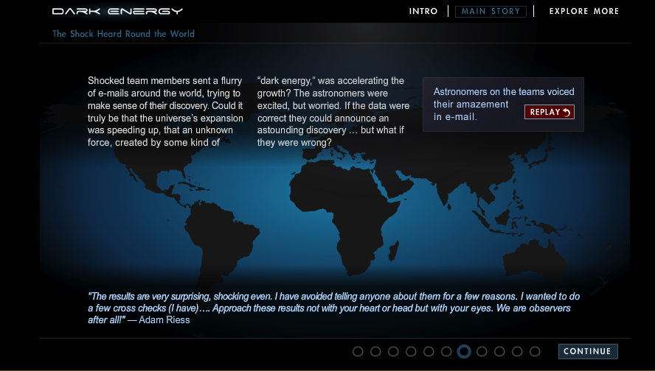

Slide 16
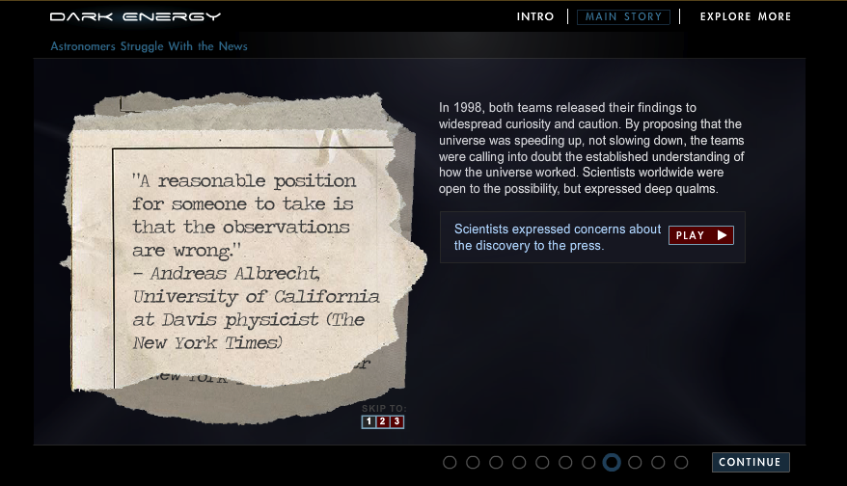

Slide 17
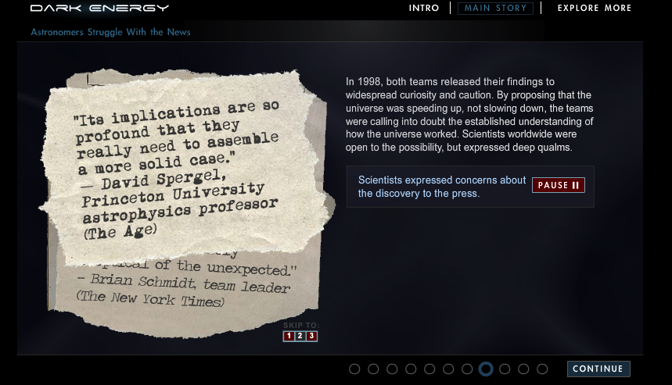

Slide 18
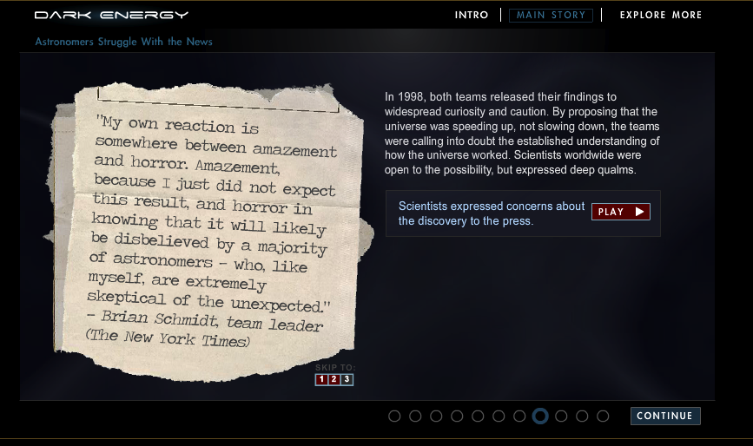

Slide 19
Supernovae data forced us to think about
a new component,
accounting for ~ 75% of the total
current energy density of the Universe.
DARK ENERGY
something that speeds up the expansion,
stretching the very fabric of the spacetime.
Notes:
note that this pressure is different from the one previously defined; I could leave here and still you would know almost as much as the next physicist about the DE

Slide 20
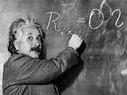
Entering the realm of speculation…
WHAT IS THE DARK ENERGY?
Maybe it is something called a Cosmological Constant:
A uniform layer of energy that fills space everywhere, sometimes also called vacuum energy.
“It’s my biggest blunder”
Einstein had predicted it,
and rejected it.
But he might have been right.
Notes:
CAVEAT!
Concept of vacuum energy is not new: atoms in their ground state have non-zero energy.

Slide 21
Paradox # 1 about the dark energy
Level of matter density
Lower level
of matter density
matter
expansion
matter
Radius of Universe
Bigger radius of Universe
Level of
Dark Energy density
SAME level of
Dark Energy density
Dark Energy
Dark Energy
expansion
Radius of Universe
Bigger radius of Universe
Notes:
here I am using CC as DE intechangeably

Slide 22
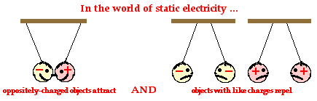
Paradox # 2 about the dark energy
We are used to forces that can be attractive or repulsive.
For example…
But could this just be anti-gravity?
No, because it does not depend on the involved masses (or any other property, like every well-behaved force!)
Notes:
It really just seems to be a property of spacetime!

Slide 23
Supernovae data then…
now ← time →past

Slide 24
and now!
now ← time → past
We have since then learned that the acceleration
only started a few billion yrs ago (as expected from Λ)

Slide 25
How did we measure this?
This diagram shows the data that we will use.
Different curves correspond to different models.
We need to understand which model works best.

Slide 26
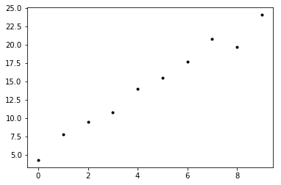
Basics of parameter estimation
In Physics we like to measure things.
Sometimes the things that we want to measure are directly measurable, for example the width of this room.
Some other times the measurements are not direct but come from a model. This process is called inference.
Say for example that you have a scatter plot with some points that show your measurements (practical example: time in seconds and distance in meters).

Slide 27
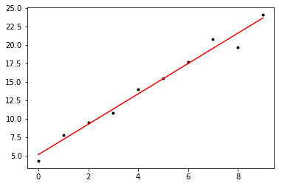
In this case, the data seems to suggest that a simple model, a straight line, could “fit” your data.
To “fit” the data means that you would be able to draw a model that goes through the data reasonably well, and allows you to predict what happens in regions not covered by the points.
For this simple case, you would draw a line through your points, and you can find (for example) the slope and intercept of this line.
The SLOPE and INTERCEPT are not measured directly, but they are inferred from your measurements + your model.
Those are the parameters of your model.

Slide 28
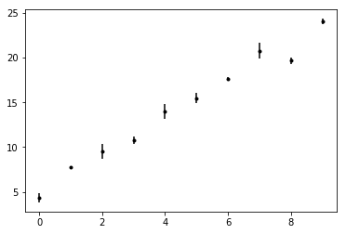
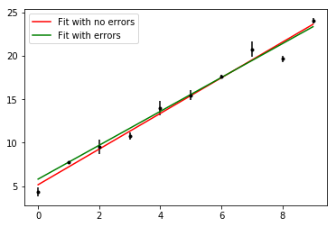
In real life, data have uncertainties associated to them.
A good thing to do is to take into account the uncertainties when we fit models to data.
Data points with larger uncertainties should matter less. This is called inverse error weighting.
Weighing the errors may lead to a different result.
The green line is a better fit to the data because
it takes into account experimental uncertainties.

Slide 29
Parameter fitting
The previous fits to straight lines were done by Python using algorithms that do stuff in the background.
If we want to fit the line ourselves (finding the parameters ”slope”, “intercept”), what should we do?
We can make a grid of all possible parameter values.
Each (slope, intercept) pair corresponds to a (unique) straight line.
The straight line that minimizes the difference between model and data, while inverse-weighing the errors is the winning model (best fit).
So we’ll go through all the possible combinations of (slope, intercept) pairs and find the one that minimizes the difference.

Slide 30
Goodness of fit: the 𝜒² function
We have seen that fitting parameters can often be achieved by finding the model that is closest fit to the data
This is ”coded” as minimizing a function (loss function or error function).
Say you have n data points. How should we write that function?
𝜒² = ∑^{n}_{i=1} (Data_{i} – Model_{i}(par1,par2,…))²/err²_{i}

Slide 31
Practice: Notebook on line fitting
Readings
https://www.nobelprize.org/nobel_prizes/physics/laureates/2011/popular-physicsprize2011.pdf
http://www-supernova.lbl.gov/PhysicsTodayArticle.pdf
http://www.nature.com/scientificamerican/journal/v314/n3/full/scientificamerican0316-38.html
(note: the above can only be downloaded while on campus)

